Slide 1


From Complexity to Clarity: Understanding the One Big Beautiful Bill (OBBB)
August 20, 2025

Slide 2
Housekeeping Matters
Submit questions at any time through the Q&A widget. Will get sent directly to the webinar producer and presenters.
Copy of slide deck and other materials located in the Resources list.
Follow your CPE progress in the Certification widget
  Answer polling questions
  Stay on for the entirety of the webinar
  Downloadable certificate will show up once you’ve received all your checkmarks
Evaluation form will appear at the conclusion of the webinar
Notes:
Value of feedback throughout
Not too late to register for days 2 and 3
Please submit your questions in the Q*A box; we have folks working behind the scenes to monitor;
Breaks are planned throughout – for example……….following our keynote speakers this morning, there will be a 5 minute break prior to the start of the accounting updates.
If you are having any technical difficulty with the software, please submit that question in the QA; our software experts are also monitoring the chat rooms and can do their best to respond and assist throughout the programs.

Slide 3







Introductions
Janelle Merlo, CPA, CFP®
Shareholder
Tax Advisory Services
412.697.5248
jmerlo@schneiderdowns.com
Maggie Havelka, JD, MBA
Shareholder
Tax Advisory Services
412.697.5273
mhavelka@schneiderdowns.com
Megan Whitlock, CPA
Shareholder
Tax Advisory Services
412.697.5097
mwhitlock@schneiderdowns.com
Brett T. Cubellis, CPA
Shareholder
Tax Advisory Services
614.586.7149
bcubellis@schneiderdowns.com
Big Thinking. Personal Focus.
Charlotte Garraway, PMP, EA
Senior Manager
Tax Advisory Services
412.697.5381
cgarraway@schneiderdowns.com
3

Slide 4

Agenda
Big Thinking. Personal Focus.
Introduction
Business Tax Provisions
State and Local Tax Updates
Individual Tax Provisions
Gift and Estate Tax Provisions

Slide 5
One Big Beautiful Bill Timeline
July 4, 2025
May 22, 2025
July 1, 2025
July 3, 2025
Budget Reconciliation Process
Most viable path because of narrow GOP Majority in Senate
Initial House version of Bill passed
President Trump signs the bill into law
Revised Senate version of Bill passed with 51-50 vote
TCJA cliff looms as President Trump takes office. Provisions set to expire 12/31/2025
January 20, 2025
House approved Senate revised version with 218-214 vote
Notes:
Budget reconciliation allows legislation impacting revenues and spending to pass the Senate with 51 votes rather than the 60-vote filibuster threshold.
For tax reform, one of the most notable is that legislation cannot increase the deficit outside of the budget window, which, currently, is 10 years.
Congressional Budget Office (CBO) projects $3 trillion increase in debt (static scoring)
White House Council of Economic Advisers (CEA) projects $4.5 trillion reduction in debt (dynamic scoring)

Slide 6
OBBB Business Tax Updates

Slide 7

§168(k) Bonus Depreciation
NEW:
Permanently extends 100% bonus depreciation deduction under §168(k) for qualified property acquired and placed in serviced on or after 1/19/2025.
Election out of 100% - Allows an election to use 40% bonus depreciation (60% in the case of property with a longer production period and certain aircraft), rather than 100% during only the first taxable year ending after 1/19/2025.
Binding contract provision - property is not treated as acquired after the date a written binding contract was entered into.
Planning Idea: Review 2025 projections and quarterly estimates to determine how retroactive changes apply. Consider state conformity as not all states will follow the expanded depreciation rules. If losses are anticipated in 2025, consider electing out of 100% bonus to preserve future deductions.

Slide 8
§168(k) Bonus Depreciation
OLD: TCJA annual tax year summary of bonus depreciation deduction percentage allowed claimed against cost:
    2018 – 2022: 100%
    2023: 80%
    2024: 60%
    2025: 40% for property acquired through 1/19/2025
NEW:
    2025: 100% for qualified property acquired on or after 1/19/2025 with option to elect 40%.
    2026 - forward: OBBB allows 100%

Slide 9
§179 Election to Expense Certain Business Property
NEW:
Expands the maximum amount a taxpayer may expense under §179 to $2.5 million, with phaseouts beginning at $4 million. Effective for property placed in service after December 31, 2024. Note that this date is different than the §168(k) effective date.
 | 2023 - OLD | 2024 - OLD | 2025 - OLD | 2025 - NEW*
Maximum Deduction | $1,160,000 | $1,220,000 | $1,125,000 | $2,500,000
Phase-out Threshold | $2,890,000 | $3,050000 | $3,130,000 | $4,000,000
*OBBB; will be indexed for inflation in future years

Slide 10
§179 Election to Expense Certain Business Property
Other Considerations:
Applies to §1245 property generally
Qualified real property eligibility
  Qualified improvement property
  Roofs
  Heating, ventilation, air-conditioning
  Fire protection and alarm systems
  Security Systems
Special rules for automobiles
Planning Idea: Similar to bonus depreciation, review 2025 projections and quarterly estimates to determine how retroactive changes apply. Consider state conformity issues. If losses are anticipated in 2025, consider timing of deductions to manage taxable income in the future.

Slide 11

§179D Energy-Efficient Commercial Building Property Deduction
Federal tax deduction designed to incentivize the construction and renovation of energy-efficient commercial buildings.
Terminates for property in which construction begins after June 30, 2026.
Enhanced deduction amounts for the remaining eligible period.

Slide 12
§168(n) Special Depreciation Allowance for Production Property
NEW: The bill adds new §168(n) providing an elective 100% deduction of the adjusted basis of “qualified production property”
Qualified Production Property: To qualify as qualified production property (QPP), the non-residential real property must meet all of the following 7 criteria:
  Must be subject to depreciation (would exclude land costs)
  Used by the taxpayer (not by a lessee) as an “integral” part of a “qualified production activity”
  Placed in service in the US, or US territory
  Its “original use” commenced with the taxpayer (exception for certain purchased property)
  Construction began after Jan. 19, 2025, and before Jan. 1, 2029 (written binding contract requirements and exception for certain purchased property)
  Designated by election
  Placed in service after July 4, 2025, but before Jan. 1, 2031
Notes:
The provision was adopted in lieu of President Trump’s 15% corporate income tax rate proposal for US-based manufacturing income.
State conforming of Sec. 168(n) will need to be addressed
QPP does not include alternative depreciation system (ADS) property.
May not be revoked without consent
IRS to issue guidance on what constitutes a substantial transformation of property consistent with guidance provided under §954(d).

Slide 13
§168(n) Special Depreciation Allowance Key Terms
Qualified Production Activity
Qualified Product
The manufacturing, production, or refining of a “qualified product” and must result in a “substantial transformation” of the product
Tangible personal property other than food or beverage prepared in the same building as a retail establishment in which it is sold
Recapture
Non–Production Property
Production
Subject to 10 yr recapture
Offices, administrative services, lodging, R&E, sales, software development, engineering, and other portions of buildings used for nonproduction purposes
Defined as agricultural production and chemical production
Notes:
Substantial transformation: Regulations will be provided consistent with guidance provided under §954(d).

Slide 14
§168(n) Special Depreciation Allowance for Production Property
SPECIAL ALLOWANCE RULE: Allows certain used property whose original use did not commence with the taxpayer, and which hasn’t been used in a production activity since Jan. 1, 2021.
Replaces items (iv) and (v) (discussed above) and the provisions are deemed satisfied when:
  Such property was not used in a qualified production activity by any person at any time during the period beginning on January 1, 2021, and ending on May 12, 2025,
  Such property was not used by the taxpayer at any time prior to such acquisition, and
  The acquisition of such property meets the requirements of paragraphs (2)(A), (2)(B), (2)(C), and (3) of §179(d).
  NOTE: the sections referenced above mean:
      2A – cannot be purchased from a related party as provided for in § 267 or § 707
      2B – cannot be purchased from a component member of a controlled group
      2C – basis is not determined in who or in part by reference to the person it was acquired
      3 – the cost of property does not include so much of the basis of such property as is determined by reference to the basis of other property held at any time by the person acquiring such property (for example a like-kind exchange)

Slide 15
§174 – Research & Experimental Expenditures Overview
Section 174 refers to “research or experimental expenditures”, meaning expenditures incurred in connection with the taxpayer’s trade or business which represent research and development costs in the experimental or laboratory sense.
  Example Section 174 expenses include:
    Employee payroll and benefits
    3rd party contractor expenses
    Supplies
    Attorney’s and patent fees
    Rent, depreciation, laboratory expenses.

Slide 16
§174 – Evolution
Prior to 2022 | TCJA (2022 – 2024) | OBBB (2025 and Beyond)
Fully deduct R&E expenses in year in which they occurred | Effective for tax years beginning after December 31, 2021, required businesses to capitalize and amortize their R&E expenditures. 5 years for domestic R&D 15 years for foreign R&D Impact of these changes: Increased taxable income Increased compliance burden | OBBB reinstates the full expensing of IRC §174 expenditures for tax years beginning after December 31, 2024, for domestic R&E spend Foreign R&E expenses under IRC §174 still need to be capitalized and amortized over 15 years Small Businesses with gross receipts less than $31M may amend the 2022 through2024 returns to fully expense IRC §174 costs in tax years 2022 through 2024 Large Businesses with gross receipts greater than $31M can accelerate deductions to 2025 or 2025 – 2026

Slide 17
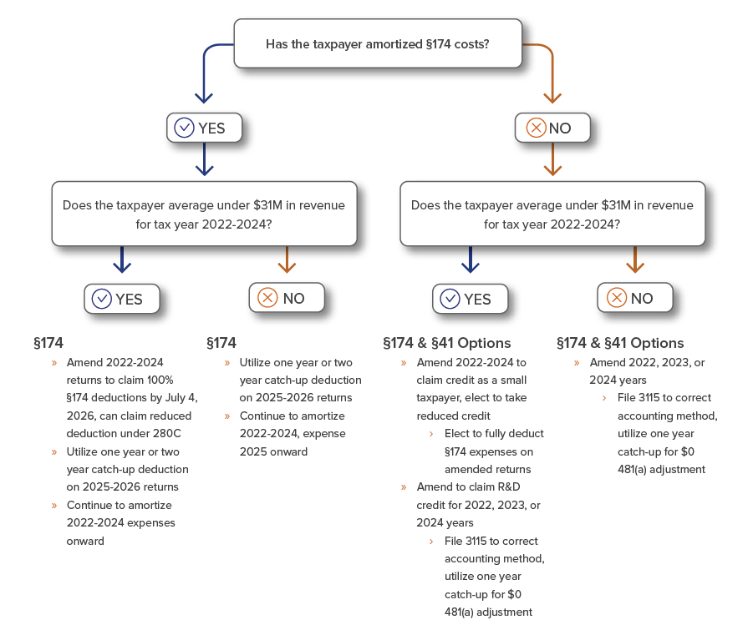

Slide 18
§ 174 Planning Ideas & Considerations
Although small businesses are eligible to amend 2022 – 2024 returns to claim 100% deductions, the timeline on the processing of these returns (and their subsequent refunds) could be significant
  Clients should consider utilizing the one-year or two-year catch-up deduction on 2025 – 2026 returns and adjusting quarterly payments to see more immediate benefit
  If small businesses are amending 2022 – 2024 returns and taxpayers are not claiming R&D credits, consult with the Credits & Incentives team
Additional guidance should be forthcoming from the Service regarding necessary elections/statements for amended returns

Slide 19
§ 174 v. § 41
Although sometimes referenced interchangeably, expenses falling under Section 174 and Section 41 are NOT the same
Section 174 includes indirect R&E expenses, while Section 41, the Research & Development tax credit, is more restrictive
Section 174 Expenses
Indirect R&E Expenses
R&E Rent
R&E Depreciation
Employee Benefits
Section 41 Expenses
Direct R&D Expenses
Wages
Supplies
Contract Research
Cloud Hosting

Slide 20
§ 41 Credit for Increasing Research Activity
Often referred to as the "R&D Credit“
First enacted in 1981, and made permanent through the PATH Act of 2015
Federal incentive designed to reward companies for investing in innovation within the United States
Many states also offer similar incentives

Slide 21
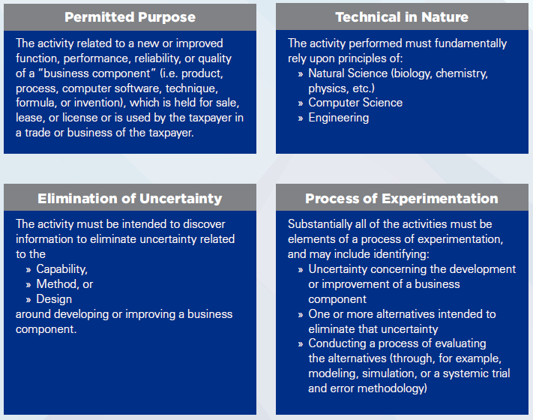
§ 41 Qualified Research - The Four-Part Test

Slide 22
§ 41 Qualified Research Expenditures (QREs)
Wages
Performing qualified research
Directly supervising qualified research
Directly supporting qualified research
Supplies
Prototype costs, tooling costs, raw materials and supplies used in the conduct of research
Contract research
Qualified services performed by a third party
Rental or lease of computers / cloud computing costs
Software development or testing environments hosted in the cloud

Slide 23
§ 41 R&D Tax Credit Calculation
Rewards increasing year-over-year qualified activities and expenses
Two calculation methods:
  Regular credit
    Based on qualifying expenses and gross receipts
    Generally preferable for start-ups
    Can be challenging for established companies to calculate (may require data from the 1980s)
  Alternative Simplified Credit (ASC)
    Based on qualifying expenses for the current and prior three tax years
    Generally easier and more accurate due to recency (three-year lookback)

Slide 24
§ 41 Qualifying Industries
All industries are eligible for the R&D Tax Credit
The following industries are more likely to have R&D activities:
  Manufacturing
  Technology / Software
  Engineering & Construction (design / build)
  Biotech / Pharmaceutical / Medical Device
  Transportation / Logistics
  Retail / Apparel
  Food & Beverage

Slide 25
§ 41 Research & Development Tax Credit under OBBB
No direct changes to R&D tax credit from OBBB
However, changes to Section 174 remove practical considerations that may have prevented Taxpayers from wanting to claim the R&D tax credit
If returns are being amended for Section 174 changes from OBBB, Taxpayers should strongly consider including R&D tax credit claim on these returns (if not previously included)

Slide 26
Inflation Reduction Act Clean Energy Credits
The OBBB eliminates several clean energy credits available to businesses including:
The OBBB eliminates several clean energy credits available to businesses including:
IRC Section | Effective Dates
§ 30D - Clean Vehicle Credit | Terminates For Vehicles Acquired After Sept. 30, 2025
§ 45W - Qualified Commercial Clean Vehicle Credit | Terminates After Sept. 30, 2025
§ 30C - Alternative Fuel Vehicle Refueling Credit | Terminates After June 30, 2026
§ 179D - Energy-efficient Commercial Buildings Deduction | Terminates for property the construction of which begins After June 30, 2026
§ 45L - New Energy-efficient Home Credit | Terminates After June 30, 2026
§45V - Clean Hydrogen Production Credit | Terminates After Jan. 1, 2028
§ 40B - Sustainable Aviation Fuel Credit | Terminates After Sept. 30, 2025
§ 48E – Clean Electricity Investment Credit (Wind & Solar)* | Terminates After Dec. 31, 2027
*New guidance issued August 15, 2025, clarified "beginning of construction" definition.
Notes:
"Beginning of Construction" Need to establish that construction has begun before July 5, 2026 by satisfying the Physical Work test. Physical work test pertains to applicable wind and solar facilities and requires work of a significant nature has begun. Notice 2025-42 provides definitions for physical work test and what activities must to met to satisfy the test.

Slide 27
§199A Qualified Business Income Deduction
The OBBB makes the §199A Qualified Business Income (QBI) deduction permanent
  Was set to expire 12/31/25 under TCJA
Deduction rate remains at 20%
  Effective tax rate on Qualified Business Income 29.6%
  Version of bill passed by the House would have raised the deduction to 23%
    Effective tax rate would have been 28.5%
The OBBB expands the §199A deduction limit phase-in range for SSTBs and entities subject to the wage and investment limitation
  Single: $50k increased to $75k
  MFJ $100k increased to $150k
Added an inflation-adjusted minimum deduction of $400 for taxpayers who have at least $1,000 of QBI

Slide 28
§163(j) Business Interest Expense Limitation
Interest Expense Limitation – Background
Deduction for interest expense limited to 30% of Adjusted Taxable Income (ATI) under pre-OBBB law & post- OBBB law
Adjusted Taxable Income (ATI) Modification
  2018 - 2021: ATI = taxable income before interest expense, NOLs, depreciation & amortization (e.g. EBIDA)
  2022 - 2024: No longer add-back depreciation & amortization to determine ATI
  2025 & Later: Back to pre-2022 rules (One Big Beautiful Bill)
    Change retroactive for all of 2025 tax year
Any limited interest amounts can be carried forward indefinitely
  Adjustments and carry-forwards reported differently for partnerships vs. S Corporations

Slide 29
§163(j) Business Interest Expense Limitation
Special Rule for Floorplan Interest Expense
  Floorplan interest expense 100% deductible but can come at a cost
    If floorplan interest exception is needed for year, dealership is NOT allowed bonus depreciation
    If ineligible for bonus depreciation - can still claim a Section 179 deduction if sufficient taxable income
  OBBB expands definition of motor vehicles to include campers and trailers
OBBB Interest Capitalization Modification
  Subjects capitalized interest to §163(j) provisions which limits avoidance of limitation by electively capitalizing interest

Slide 30
"No Tax" on Tips and Overtime Compensation
Tips Deduction
Amount: Max $25k individual tax deduction (MFJ or Single) on qualified tips
  Income phase-out: $150k single/MFS ; $300k MFJ
Allowed only on tips received in an occupation that customarily receives tips
  Secretary of the Treasury to identify those occupations by early October (90 days from OBBB enactment)
  Employees in a specified service trade or business (accountants, attorneys, consultants, medical professionals, etc.) are NOT eligible
Tips must be voluntarily paid by the customer
Overtime Deduction
Amount: Max $12,500 (single) or $25,000 (MFJ) individual tax deduction against qualified overtime compensation
  Income phase-out: $150k single/MFS ; $300k MFJ
Qualified overtime compensation includes pay that exceeds an employee's regular rate of pay
  "Half" portion of "time-and-a-half"
  Overtime pay must be required by Section 7 of the Fair Labor Standards Act (FLSA)
Tip & Overtime Employer Payroll Reporting Obligation​s
2025 Form W-2 will not change; further guidance needed how to provide employees with needed information
Both tips and OT still fully subject to Social Security and Medicare taxes; no change to withholding/ current take-home pay
Temporary Deductions: Both effective 2025 - 2028

Slide 31
1099 Reporting
The OBBB increased the 1099 reporting threshold to $2,000 starting in 2026 (indexed for inflation)
1099 reporting threshold still $600 for 2025
Reminder – All information returns (W-2s, 1099s, 1095s, 8300, etc.) are now required to be e-filed. Required if at least 10 information returns.

Slide 32
C-Corporation Charitable Contribution Deduction Limitation
OLD:
10% of taxable income ceiling limit (max) on deductible charitable contributions
  Any excess carried forward 5 yrs.
NEW:
1% of taxable income floor added by OBBB
  Only charitable contributions that exceed 1% of taxable income are deductible
10% of taxable income ceiling (max) limit still applies
  Any excess carried forward 5 yrs.
Effective for tax years beginning after 12/31/2025
All else equal: charitable contributions in 2025 will be worth more of a tax benefit than in 2026

Slide 33
§ 1202 Qualified Small Business Stock Gain Exclusion
      Non-corporate taxpayers can potentially exclude 100% of the gain recognized from the sale Qualified Small Business Stock ("QSBS")
        Encourages investment in early-stage domestic C-Corporations
        Must meet holding period & corporation size requirements
      Qualified Small Business Stock
        Stock issued by a domestic C Corporation through Original Issuance
        Corp. must have gross assets equal to or less than $50M (pre-OBBB), $75M (July 5, 2025 on) at issuance
        Stock must be issued by a "qualified trade or business" which exclude:
          Service based businesses where principal asset is reputation or skill of 1 or more employees (health, law, engineering, accounting, consulting, athletics, banking
          Farming, oil & gas, hotels, restaurants, real estate, others

Slide 34
§1202 Qualified Small Business Stock Gain Exclusion
      OBBB creates a tiered approach for gain exclusion for QSBS acquired after the date of enactment (July 5, 2025 & on):
      Gain Exclusion Amount:
        Stock Acquired through July 4, 2025: Greater of $10M OR 10x the adjusted basis of the QSBS
        Stock Acquired July 5, 2025, onward (OBBB): Greater of $15M OR 10x the adjusted basis of QSBS
Stock Acquisition Date | Holding Period | 1202 Gain Exclusion %
8/11/1993 – 2/17/2009 | More than 5 years | 50%
2/18/2009 – 9/27/2010 | More than 5 years | 75%
9/29/2010 – 7/4/2025 | More than 5 years | 100%
7/5/2025 onward | 3 years | 50%
7/5/2025 onward | 4 years | 75%
7/5/2025 onward | 5 years or more | 100%

Slide 35
§1202 Qualified Small Business Stock Gain Exclusion
      OBBB §1202 QSBS Modification Summary:
        Phased in increase of gain exclusion on sale of QSBS depending on holding period (3 – 5 yrs.)
        Increase per issuer gain exclusion limitation from $10M to $15M
          10x adjusted basis still applicable if greater
        Increase Aggregate Gross Asset test from $50M to $75M
        Annual inflation adjustments for gain exclusion and gross asset test beginning in 2027

Slide 36
§1400Z Qualified Opportunity Zone (QOZ) Modifications
The OBBB makes the §1400Z Qualified Opportunity Zone (QOZ) program permanent
  Program was set to expire for new investments on 12/31/26 under TCJA
Creates a Two-tier system:
  Investments made before December 31, 2026
  Investments made after December 31, 2026
Maintains three main tax benefits similar to those under TCJA with some modifications:
  1. Temporary deferral of current capital gain – rolling 5 yrs. from investment date
    TCJA deferrals end on 12/31/26
  2. 10% current capital gain permanent exclusion (basis step-up) – after 5 yr. holding period
    30% for Qualified Rural Opportunity Fund investment
  3. Permanent future gain exclusion on QOZ investment appreciation – after 10 yr. holding period
    OBBB clarifies that the basis step-up will be frozen at FMV after 30 yrs.

Slide 37
§1400Z Qualified Opportunity Zone (QOZ) Modifications
Rolling Designations:
  States will re-evaluate and nominate census tracts for QOZ inclusion every 10 years, ensuring designations align with current needs
  Recurring 10-year designation cycle, starting July 1, 2026
Emphasis on Rural Areas:
  The OBBB introduces Qualified Rural Opportunity Funds (QROFs), offering enhanced tax benefits to stimulate investment in rural zones, including:
    A 30% basis step-up (compared to 10% for standard QOFs) after five years
    Lowered "substantial improvement" threshold for existing structures to 50% (compared to 100% for standard QOFs)
      Substantial improvement change is effective immediately (most other QOZ changes effective in 2027)
    Mandate that at least 33% of new OZ designations (or all eligible rural areas, if less than 33%) must be located in entirely rural communities
  Rural Area:
    Any city or town with a population of less than 50,000, excluding census tracts adjacent to a town or city with a population of more than 50,000

Slide 38
§1400Z Qualified Opportunity Zone (QOZ) Modifications
Stricter Opportunity Zone Eligibility Criteria:
  QOZ designations now focus on genuinely distressed communities
    OBBB eliminated contiguous tracts that previously qualified based on proximity to low-income areas
  New QOZ Eligible Census Tract thresholds:
    Median family income below 70% of the state or metropolitan median (reduced from 80% under TCJA)
    OR:
    Poverty rate of at least 20%
      However, if poverty rate > 20% but median family income exceeds 125% tract is disqualified to prevent gentrification
    These changes are expected to reduce the number of eligible census tracts available vs. current
Increased Transparency and Accountability:
  The OBBB significantly expands compliance and reporting requirements
  Enacts higher penalties for noncompliance

Slide 39
Employer Provided Meals
After December 31, 2025, the deduction for employer provided meals will be fully disallowed, including:
  Employer-Operated Eating Facilities
  Overtime meals
  Meals during business meetings in the office (without customers or clients)
  Meals for employees on call
Limited exception to the §274(o) rules for the following employer provided meals:
  Restaurants that sell food and beverages to customers and also provide meals to employees
  Fishing vessels and certain fish processing facilities
  Oil or gas platforms, drilling rigs, support camps
Some uncertainty if disallowance applies to snacks and beverages (generally considered to be a de minimis fringe benefit) or even to occasional lunches with employees off-premises
Employee picnics, holiday parties, etc. (primarily for benefit of non-highly compensated employees) remain 100% deductible

Slide 40

OBBB State and Local Tax Updates

Slide 41
State Tax Implications: IRC Conformity
States generally conform to the IRC based on their conformity statutes:
  Rolling conformity
    Conform to the IRC automatically as the IRC is amended
  Static Conformity
    Conform to the IRC as of a specific date
  Selective Conformity (only a few states – PA individual tax)
    State picks what federal provisions are adopted into their state tax codes
Currently the states are in about a 50/50 split between rolling and static conformity

Slide 42
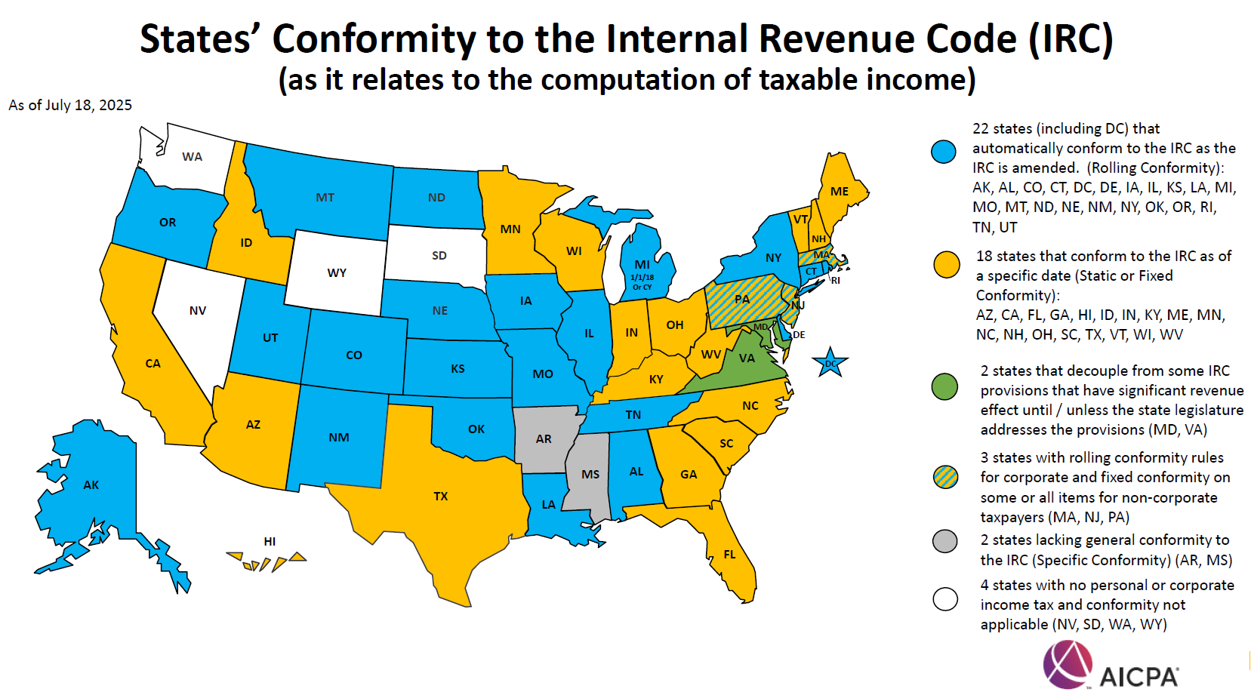

Slide 43
OBBB Individual Tax Updates

Slide 44
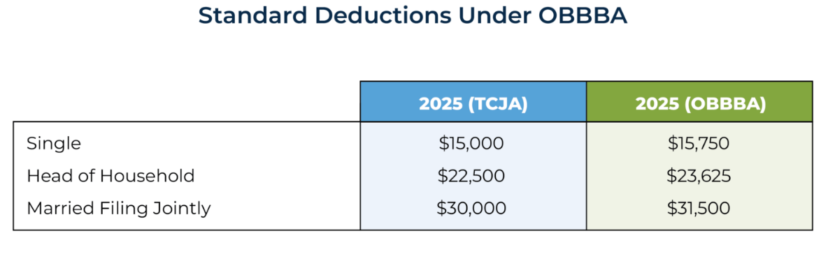
TCJA Provisions Made Permanent
The seven existing tax brackets and rates created by the TCJA remain
  10%, 12%, 22%, 24%, 32%, 35%, 37%
  The 10% and 12% brackets were widened
  All brackets will continue to be indexed for inflation
Standard deduction remains, is enhanced in 2025 and will increase with inflation.

Slide 45
TCJA Provisions Made Permanent
Mortgage interest limitation remains at $750,000
  One change: mortgage interest premiums are now deductible starting in tax year 2026
Miscellaneous itemized deductions have been permanently disallowed
  Prior to TCJA, these included items such as investment expenses, accounting fees, and unreimbursed employee expenses
  One change: educator expenses are no longer considered miscellaneous deductions and are allowed as an itemized deduction. This is in addition to the deduction for educator expenses allowed on Schedule 1 (which is limited to $300 or $600 MFJ)

Slide 46
Itemized Deduction Limitation
Itemized Deductions Limited
  There will be an overall limit on the tax benefit of itemized deductions (including SALT deductions, charitable contributions, and mortgage and investment interest) at 35%, meaning the highest bracket taxpayers will be capped at deducting 35% of itemized deductions rather than 37%
    2% haircut
    The 37% tax bracket is reached at roughly $626,000 Single and $752,000 MFJ
  This provision goes into effect in tax year 2026
  Consider bunching deductions into 2025

Slide 47
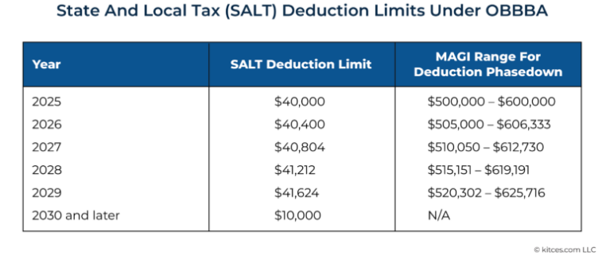
SALT Deduction
The SALT deduction cap will be temporarily increased from $10,000 to $40,000 beginning in tax year 2025
The cap will increase by 1% through tax year 2029, after which it will return to $10,000
In 2025, the deduction begins to phase out for taxpayers with MAGI over $500,000, and is completely phased out at $600,000.

Slide 48
Charitable Giving Updates
The TCJA provision allowing taxpayers to deduct up to 60% of AGI for cash donations to public charities is now permanent.
From 2026, a 0.5% AGI floor applies to individual charitable deductions, with limited carryforward for disallowed amounts.
Planning Idea: Taxpayers receiving IRA distributions may benefit from Qualified Charitable Distributions (QCDs) to maximize deductions under these rules. QCDs offer a dollar-for-dollar exclusion from income.

Slide 49
Charitable Giving Updates (continued)
Contributions to Scholarship Organizations
A new tax credit has been included for contributions made to §501(c)(3) organizations that grant scholarships to private or religious, elementary & secondary schools
Effective: tax year 2027
Limit: Lesser of the amount contributed or $1,700; further reduced by any amount allowed as a state tax credit.
Reinstatement of Partial Deduction for Charitable Contributions of Individuals Who Do Not Itemize
The legislation reinstates the ability to claim amounts given as cash contributions to qualified charities subject to limits by filing status
Effective: tax year 2026
Limit: Single filers can deduct up to $1,000 and MFJ filers up to $2,000
Note: Contributions to Donor Advised Funds will not qualify

Slide 50
§461(l) Excess Business Loss Disallowance
§461(l)(1) limitation on excess business losses of noncorporate taxpayers is now permanent. It was scheduled to expire after 2028.
Excess business loss carryovers remain an NOL potentially allowing faster recovery.
The excess loss minimum threshold is not amended. The threshold amount ($250,000 Single and $500,000 joint) is indexed for inflation for taxable years beginning after 2018. The threshold amount for a taxable year beginning in 2025 is $313,000 ($626,000).
Recall that business operating losses must run a gauntlet of potential limitations on deductibility; these are the (i) basis limitation; (ii) At-Risk basis limitation; (iii) passive activity loss limitation; (iv) excess business loss limitation and (v) net operating loss limitations.

Slide 51
Repealed Energy Credits
In general, most energy credits available to individual taxpayers have been terminated after tax year 2025.
These include:
  Sec. 25C, Energy Efficient Home Improvement Credit
  Sec. 25D, Residential Clean Energy Credit
  Sec. 25E, Previously Owned Clean Vehicle Credit
  Sec. 30D, Clean Vehicle Credit
  Sec. 45L, New Energy Efficient Home Credit
  Sec. 45W, Commercial Clean Vehicle Credit

Slide 52
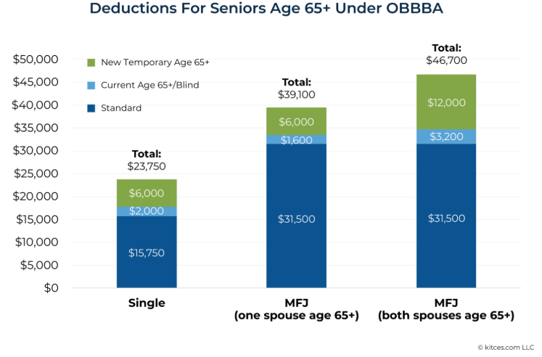
“No Tax” on Social Security
Enhanced deduction for those 65+.
Effective: tax years 2025 through 2028
Max Deduction: $6,000
Phaseout:
  Single taxpayers with MAGI > $75k; fully phased out at $175k
  MFJ with MAGI > $150k; fully phased out at $250k
Deduction not adjusted with inflation
Available for both itemizers and non-itemizers
**Note that social security income is still subject to tax.

Slide 53
Child Tax Credit Enhancement
There is a permanent increase in the child tax credit from $2,000 to $2,200 (indexed for inflation)
  Up to $1,700 can be refundable under certain circumstances
Effective: tax year 2025
Max Credit: $2,200
Phaseout: Single $200,000, MFJ $400,000

Slide 54
Car Loan Interest Deduction
Maximum Annual Deduction: $10,000 on individual tax return
Eligible Tax Years: 2025 – 2028
Income Phase-Out: $100k Single/MFS; $200k MFJ
“Qualified Interest” must be paid on a loan that is:
  Originated after December 31, 2024
    If a qualifying vehicle loan is later refinanced, interest paid on the refinanced loan will also be deductible.
  Used to purchase a new vehicle (used vehicles do NOT qualify)
  Secured by a lien on the vehicle
“Qualified Vehicle”:
  Car, minivan, van, SUV, pick-up truck, or motorcycle with GVWR < 14,000 lbs.
    AND
  That vehicle has undergone final assembly in the United States

Slide 55
Car Loan Interest Deduction
To determine if a vehicle had final assembly in the United States, taxpayers can use:
  Information label attached to the vehicle on a dealer’s premises
  The Vehicle Identification Number (VIN)
    VINs starting with 1, 4, or 5 indicate U.S. final assembly
  The National Highway Traffic Safety Administration (NHTSA) VIN Decoder
Taxpayers must include the VIN of the vehicle on their tax return to claim the deduction
Lenders will file information returns (similar to mortgage interest) with the IRS and furnish a copy to taxpayers reporting the amount of interest received during the tax year

Slide 56
Additional Considerations for Individuals:
Casualty Loss Deduction: Permanently Limited to Federally Declared Disasters but adds exception for certain state declared disaster areas
Gambling Losses: A New Cap on Deductibility
  Individuals can only deduct 90% of losses and only up to the amount of winnings
529 Plans Get a Boost Under the OBBB Act
  Annual tax-free withdrawal limit for K-12 tuition expenses doubled from $10k to $20K
  Definition of qualified K-12 expenses has broadened to include costs beyond just tuition
Savings Opportunity for Minors- Trump Accounts
  Tax-deferred investment account
  Government Contribution: $1k deposit for children born in 2025 through 2028
  Annual Contribution: Parents, employers, or charitable organizations can contribution up to $5k per year
Enhancement to Adoption Credit
  Prior to the OBBB the adoption tax credit was entirely non-refundable. Beginning in 2025, the credit becomes partially refundable up to $5k

Slide 57
Gift and Estate Tax
  Estate tax exemption was set to revert to pre-2018 levels, adjusted for inflation on 1/1/2026
  One Big Beautiful Bill permanently increases the estate tax exemption to $15M per person effective 1/1/2026, indexed annually for inflation.
Gift and Estate Tax Exemption Amounts
 | 2017 | 2025 | 2026 & Later (OBBB)
Gift Tax Annual Exclusion | $14,000 | $19,000 | TBD
Gift/Estate/GST Exemption | $5,490,000 | $13,990,000 | $15,000,000
Planning Idea: Estate planning freeze techniques and multi generation planning should still be considered as timely and necessary planning for high net worth taxpayers. Additionally, regardless of net worth, estate plans should be implemented for a number of reasons, such as business succession planning, asset protection, state estate/inheritance tax considerations, avoiding probate, and protecting generational wealth.

Slide 58
Tax Tidbits

Slide 59

Executive Order 14247 – Modernizing payments
  WHAT: On March 25, 2025, year President Trump signed Executive Order 14247, Modernizing Payments to and from America’s Bank Account. Mandates the phase-out of paper check receipts and disbursements to all federal agencies including the IRS.
  WHY: Reduce costs (~$657M in FY 2024), improve efficiency, lower fraud risk, and enhance security
  WHEN: September 30, 2025, scheduled phase-out of paper check payments. After this date, most payments to and from the IRS must be submitted electronically
WHO: All taxpayers should be fully prepared before October 15, 2025, for electronic payments, particularly individuals that filed extensions of their individual income tax returns (Form 1040) that might have an overpayment or underpayment
Notes:
where allowed by law
Good idea if you are expecting to have a payment or refund to set up accounts now as there is an alert on the IRS site that payment processing is delayed

Slide 60
Executive Order 14247 – Modernizing payments
  PAYMENT OPTIONS: IRS currently offers numerous payment options on their site. These include:
  On-line account
  IRS Direct Pay – online transfers directly from a checking or savings account at no cost to taxpayer
  Debit & credit cards or digital wallet subject to a 2%
  Pay by phone
  Electronic Federal Tax Payment Systems (EFTPS) – Allows payment of taxes online or by phone directly from a checking or savings account. There is no fee but
taxpayer must enroll either online or by having an enrollment form
mailed
  Electronic Funds Withdrawal (EFW) – an integrated e-file/e-pay option offered when filing federal taxes electronically using tax preparation software through a tax professional or the IRS

Slide 61
Executive Order 14247 – Modernizing payments
  EXCEPTIONS: The order provides certain exceptions to the payment and collection mandate in limited circumstances including:
  Individuals who do not have access to banking services or electronic payment systems
  Certain emergency payments where electronic disbursement would cause undue hardship, as contemplated in 31 CFR Part 208
  National security-related or law enforcement-related activities where non-EFT transactions are necessary
  Other circumstances as determined by the Secretary of the Treasury as reflected in regulations or other guidance
Notes:
No official guidance has been issued to date

Slide 62
Thank You

Slide 63


Additional Resources

Slide 64
Summary Charts

Slide 65
Key Individual Tax Provisions - OBBB
Tax Provision | Current Law | One Big Beautiful Bill | Effective Date
Individual Tax Rates | 7 Brackets: 10%, 12%, 22%, 24%, 32%, 35%, & 37% TCJA rates set to expire 12/31/25 –top rate back to 39.6% | Makes TCJA tax rates permanent, retains the same 7 brackets. Widens 10% and 12% brackets | 1/1/2026
Standard Deduction | Single/MFS: $15k MFJ: $30k HoH: $22.5k TCJA increase set to expire 12/31/25 | Permanently increase standard deductions and index to inflation: Single/MFS: $15,750 MFJ: $31,500 HoH: $23,625 | 1/1/2025
Enhanced Deduction for Seniors | Age 65+: $2k additional standard deduction | Age 65+: $6k bonus deduction Income phase-out: $75k single/MFS ; $150k MFJ | 1/1/2025 – 12/31/2028
Child Tax Credit | $2k per child through 2025, $1k per child after 2025 Income phase-out: $200k single/MFS ; $400k MFJ | Permanently increase to $2,200($1,700 refundable) per child indexed for inflation. Adds parent SSN requirement for eligibility | 1/1/2025

Slide 66
Key Individual Tax Provisions - OBBB
Tax Provision | Current Law | One Big Beautiful Bill | Effective Date
State and Local Tax (SALT) Deduction Cap | $10k limitation | Cap increased to $40k for 2025, + 1% increase through 2029. Increase subject to phase-out if income > $500k | 1/1/2025 – 12/31/2029
No Tax on Overtime | Overtime pay is taxable income | $12,500 deduction per taxpayer ($25k MFJ) against qualified overtime compensation. Income phase-out: $150k single/MFS ; $300k MFJ | 1/1/2025 – 12/31/2028
No Tax on Tips | Tips are taxable income | $25k deduction against qualified tips. (single or MFJ) Income phase-out: $150k single/MFS ; $300k MFJ | 1/1/2025 – 12/31/2028
No Tax on Car Loan Interest | Car loan interest is not deductible | $10k deduction of new car loan interest on vehicles assembled in United States. Income phase-out: $100k single/MFS; $200k MFJ | 1/1/2025 - 12/31/2028

Slide 67
Key Individual Tax Provisions - OBBB
Tax Provision | Current Law | One Big Beautiful Bill | Effective Date
Charitable Deductions (Non-Itemizers) | n/a – was temporarily allowed in 2021. | $1k single/MFS; $2k MFJ cash charitable contribution deduction allowed even if do not itemize. Made permanent. | 1/1/2026
Charitable Deductions (Itemizers) | Taxpayers who itemize can deduct contributions subject to limitations on the type of contribution | Charitable contribution deduction allowed only to the extent the contribution exceeds 0.5% of the taxpayer’s AGI. | 1/1/2026
Itemized Deduction Phase-Out | TCJA suspended through 2025 | 2% limitation on taxpayers in the 37% tax bracket (starts at $626k single/MFS ; $751k MFJ) 35% deduction on itemized deductions | 1/1/2026
Gambling Losses | Itemized deduction for losses, limited to amount of winnings | Itemized deduction, further limited to 90% of losses, up to the extent of winnings | 1/1/2025

Slide 68
Key Business Tax Provisions - OBBB
Tax Provision | Current Law | One Big Beautiful Bill | Effective Date
§168(k) Bonus Depreciation | 2025: 40% 2026: 20% 2027 & thereafter: 0% | 100% additional first year bonus depreciation deduction on eligible property | Eligible property acquired and placed in service on or after 1/19/25
§168(n) Special Depreciation Allowance for Production Property | N/A | Full expensing provision for “qualified production property | Qualified property construction of which begins after January 19, 2025, and before January 1, 2029, and placed in service after date of enactment and prior to January 1, 2031
§179 Expense | Max Deduction: $1.25M Investment Phase-Out: $3.13M | Max Deduction: $2.5M Investment Phase-Out: $4M | 1/1/2026
§199A Qualified Business Income (QBI) Deduction | 20% deduction against eligible non-corporate business income; expires after 2025 | Deduction remains at 20% & made permanent. Adds minimum deduction of $400 on QBI of $1,000 | 1/1/2026

Slide 69
Key Business Tax Provisions - OBBB
Tax Provision | Current Law | One Big Beautiful Bill | Effective Date
§163(j) Business Interest Expense Limitation | 30% limit on deductible interest based on earnings before interest (EBI). No add-back for depreciation & amortization 2022 & later | Permanently returns to EBITDA for “adjusted taxable Income” calculation (allows add-back for depreciation and amortization). Includes RV & Campers as floorplan motor vehicles. Subjects capitalized interest to §163(j) provisions (limiting avoidance) | Taxable years beginning after 12/31/2024 (except interest capitalization rules which are effective for tax years beginning after 12/31/2025).
§461(l) Excess Business Loss Limitation | Non-corporate taxpayer business losses limited to: MFJ: $626k; All Others: $313k Excess carried forward as NOL | Makes 461(l) permanent and retains NOL c/f treatment

Slide 70
Key Business Tax Provisions - OBBB
Tax Provision | Current Law | One Big Beautiful Bill | Effective Date
Employer Reporting of Exempt Tip and Overtime Compensation | N/A | Reporting requirements placed on employers to allow employees to claim deduction | 12/31/2025
Form 1099 Informational Reporting | 1099 reporting threshold $600 | 1099 reporting threshold increased to $2,000 indexed for inflation | 1/1/2026
§1202 and Impact on Business Entity Selection | $50,000,000 gross asset limit $10,000,000 gain/issuer limit | $75,000,000 gross asset limit $15,000,000 gain/issuer limit Tiered Holding period Gain Exclusion | 7/4/2025
C-Corp Charitable Deductions | 10% of taxable income limit; excess carried forward | Adds 1% floor; only contributions above 1% of taxable income deductible, up to prior 10% limit | 1/1/2026

Slide 71
Key Business Tax Provisions - OBBB
Tax Provision | Current Law | One Big Beautiful Bill | Effective Date
§460(e) percentage of completion exception expanded | N/A | Expands the exception that currently applies to home construction contracts to cover any residential construction contracts. | July 4, 2025
§274(o) Business Meals for the Convenience of the Employer | 50% deductible | 0% deductible (with certain limited exceptions added) | Amounts paid or incurred after 12/31/2025
§162(m) Certain Excessive Employee Compensation | Limits deduction of certain employees of publicly held companies to $1,000,000 | Expands on the definition of covered employee | Taxable years beginning after 12/31/2025.
Employee Retention Credit | Q3 & Q4 2021 ERC claims allowed until 4/15/25 | Prohibits payment of Q3 and Q4 2021 claims filed after 1/31/24

Slide 72
Helpful Links

Slide 73
Helpful Links
One Big Beautiful Bill | Resource Center | OBBB
Our Thoughts On Archive - Schneider Downs

